Slide 1
HERPES SIMPLEX DENDRITIC ULCER
Prepared by:
Nutrimala Nadia Nasip
Ulfa Nur Izzati Abd. Wahid
Deena Khairiah Baharuddin
Siti Nur Hazwanti Hamzah
Ophthalmology department
4th year Zagazig University

Slide 2
INTRODUCTION
It is a primary, superficial, infective ulcer having a dendritic shape caused by Herpes Simplex Virus (epitheliotropic type).

Slide 3
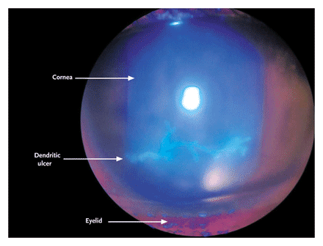
Dendritic ulcer stained with fluorescin

Slide 4
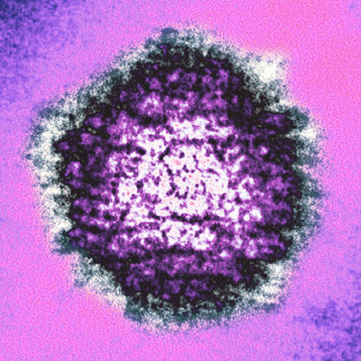
Herpes Simplex virus

Slide 5
PATHOPHYSIOLOGY
HSV-1
Primarily responsible, above waist
Orofacial & ocular infection
HSV-2
Transmitted sexually
Genital diseases, passed to neonates

Slide 7
1ry HSV-1 infection; in childhood
Direct contact of skin or mucous membrane with virus-laden lesions or secretions
Inter-neuronal spread
Virus becomes dormant in trigeminal (V) ganglion

Slide 8
PREDISPOSING FACTORS
Low resistance
Fever
Menstruation
Drugs
Psychic stress

Slide 9
Recurrence occurs with decreased body resistance
Virus becomes active
Vesicles in mouth, genitalia, cornea

Slide 10
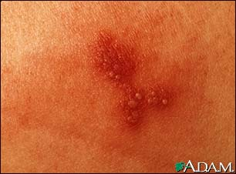
Close-up view of early herpes outbreak shows small, grouped blisters (vesicles) and lots of inflammation (erythema).

Slide 11
FREQUENCY
HSV infection is ubiquitous, with an estimated one third of the population worldwide suffering from recurrent infections.

Slide 12
CLINICAL ASPECTS OF DENDRITIC ULCER

Slide 13
HISTORY
Patients with HSV keratitis may complain of the following:
Pain
Photophobia
Poor vision
Profuse lacrimation
Blepharospasm

Slide 14
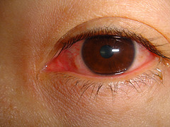

Slide 15
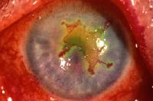
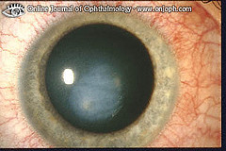
SIGNS
Infectious epithelial keratitis
Corneal stromal inflammation

Slide 16
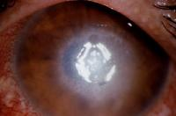
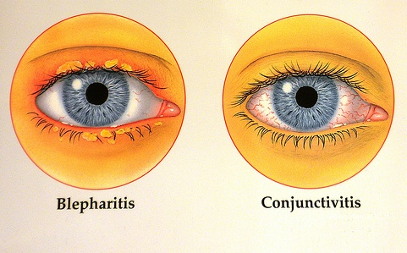
Endothelitis
Blepharo-conjunctivitis

Slide 17
DIAGNOSIS
Rose bengal
Fluorescin
Mix

Slide 18
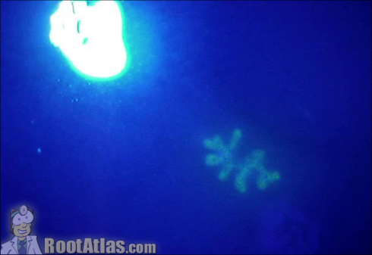
Dendritic ulcer stained with fluorescin

Slide 19
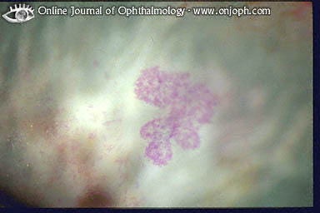
Dendritic ulcer stained with Rose Bengal

Slide 20
COMPLICATIONS
Eye infection
Throat infection
Eczema herpeticum

Slide 21
Erythema multiform
Nervous system
Widespread infection

Slide 22
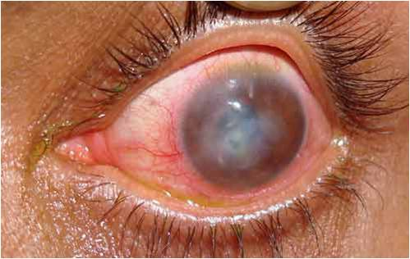
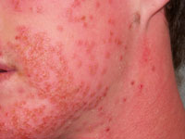
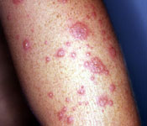

Slide 23
DIFFERENTIAL DIAGNOSIS
Bacterial & fungal keratitis
Superficial punctate keratitis
Peripheral ulcerative keratitis

Slide 24
Acanthamoeba keratitis
Interstitial keratitis
Photokeratitis

Slide 25
TREATMENT
Local
Antiviral (acyclovir)
Local antibiotic
General
Vit A & Vit C
Acyclovir tablet
Resistant
Debridement
Therapeutic keratopathy
Atropine
Bandage
Cauterization

Slide 26
Thank You

