Slide 1
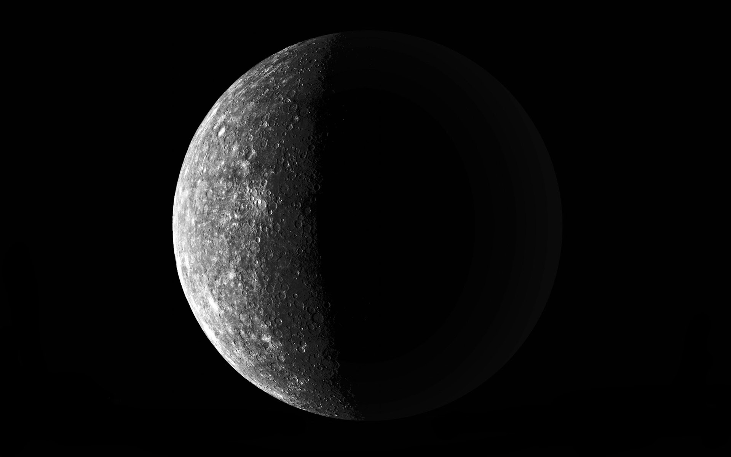
Management of iridocyclitis
Prepared by:
•Naufal B. Abidin
•Farhan B. Ibrahim
•Mohd. Hazwan B. Zulkifli
(4th year medical students)

Slide 2
DEFINITION
Acute or chronic inflammation of the iris and ciliary body characterized by exudates into the anterior chamber, discoloration of the iris, and constricted, sluggish pupil. Symptoms include radiating pain, photophobia, lacrimation, and interference with vision

Slide 3
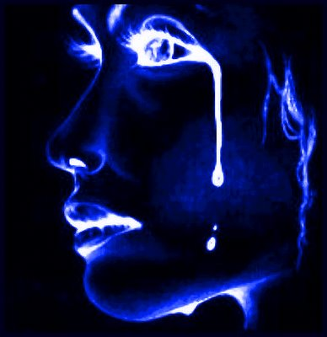
1)Photophobia
2)Lacrimation
1)Photophobia
2)Lacrimation
Clinical Picture
Symptoms:
1) Photophobia
2) Lacrimation
3) Pain
4) Diminution of vision
5) Redness

Slide 4
1)Lids : edematous
2)Conjunctiva : ciliary injection
1)Lids : edematous
2)Conjunctiva : ciliary injection
Signs
1) Lids : edematous
2) Conjunctiva : ciliary injection
3) Cornea : show keratic precipitates due to deposition of cell on its posterior surface
4) Anterior chamber :Aqueous flare, hyphaema and hypophyon.
5) Pupil
6) Muddy Iris
7) Vitreous
8) High intra ocullar pressure.

Slide 5
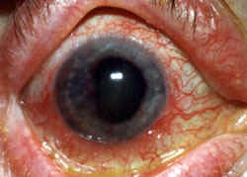
Ciliary Injection

Slide 6
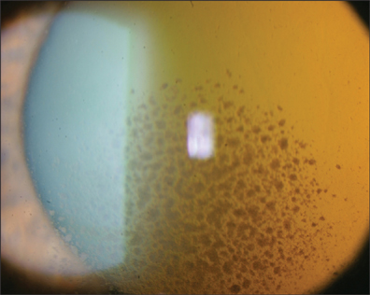
Keratic Precipitates

Slide 7
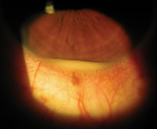
Hypopyon

Slide 8
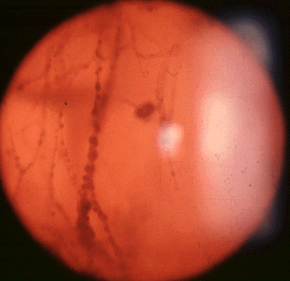
Cloudy Vitreous

Slide 9
Differential diagnosis
Difference | Acute Iritis | Acute Glaucoma | Acute Conjunctivitis
Pain | Neuralgic | Severe Bursting | Only Discomfort
Vision | Diminished | Very Poor | Not Affected(Haloes)
Discharge | No Discharge | Very Poor | Present
Lids | Normal or Edema | Edematous | Edematous
Conjunctiva | Ciliary Injection | Ciliary Congestion | Conjunctival Injection
Cornea | Edema KPS | Steamy(Edema) | Normal
A C | Flare+Cells+Hypopyon | Very Shallow | Normal
Iris | Muddy | Congested | Normal
Pupil | Small Irregular | Dilated Oval | R R A
Tension | Normal or High | Very High | Normal

Slide 10
INVESTIGATIONS
Children and adults with uveitis and other inflammatory eye diseases may be eligible for
this study. Candidates will be screened with a medical history, brief physical examination, thorough eye examination and blood tests. The eye examination includes measurements of visual acuity (ability to see the vision chart), eye pressure and dilation of the pupils to examine the lens and retina (back part of the eye). Patients may also undergo the following procedures:
•Fundus photography - Special photographs of the inside of the eye to help evaluate the
status of the retina and evaluate changes that may occur in the future. From 2 to 20
pictures may be taken, depending on the eye condition. The camera flashes a bright light into the eye for each picture.
•Fluorescein angiography - Procedure to evaluate the eye's blood vessels. A yellow dye
injected into an arm vein travels to the blood vessels in the eyes. Pictures of the retina
are taken using a camera that flashes a blue light into the eye. The pictures show if any
dye has leaked from the vessels into the retina, indicating possible blood vessel
abnormality.
Participants will be followed at least 3 years.
Follow-up visits are scheduled according to the standard of care for the individual
patient's eye problem. Vision will be checked at each visit, and some of the screening
tests described above may be repeated to follow the progress of disease and evaluate
the response to treatment.Condition :Choroiditis , Iridocyclitis , Iritis , Retinal Disease

Slide 11
Another Classifications
1.Clinical
a)History of Syphilis,TB,Gonorrhea
b)Local examination for characteristic signs e.g Rubeosis Iridis in Diabetic Iritis
c)Search for septi foci
d)Systemic manifestations of associated diseases
2.Radiological : X-ray chest for TB or Sarcoidosis and spine for Ankylosing Spondylitis
3.Laboratory
a)Urine : For sugar,pus cells,albumin,uric acid
b)Stool : For parasites
c)Tuberculine test
d)Blood : For culture,W.R,Blood film for Malaria,etc.
e)ELISA or Casoni Test : For Hydatid Disease
f)ELISA test and Plasma Titer : Taxoplasmosis,toxocariasis

Slide 12
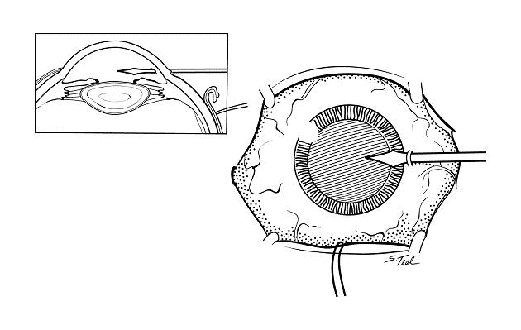
4.Surgical diagnostic procedures :
a)Paracentesis or Vitreal biopsy
b)Biopsy of associated skin nodule : To confirm sarcoidosis
5)Fluorescin Angiography.

Slide 13
Other Underlying conditions related to iridocyclitis
•Anisocoria
•Cataracts
•Eye pain
•Glaucoma, secondary
•Heterochromic iris
•Hyperlacrimation
•Iris abnormality
•Photophobia
•Pupillary constriction

Slide 14
symptomS
Conditions listing Iridocyclitis as a symptom may also be potential underlying conditions:
• Behcet's Disease
• Besnier-Boeck-Schaumann disease
• Leprosy
• Systemic Juvenile Rheumatoid Arthritis
• Vogt-Koyanagi-Harada Syndrome

Slide 15
TREATMENT
LOCAL
COMPLICATED
GENERAL

Slide 16
2. Dark glasses:
2. Dark glasses:
Treatment
Local Treatment:
Hot fomentation:
Dark glasses.
Mydriatics and cycloplegics (Atropine Sulphate 1%)
Local cortisone
Bandage and local antibiotics.
(B) General Treatment :
1. Treatment of the cause.
2. Anti inflammatory drugs ( steroidal or non-steroidal).
3. Eradication of septic foci.
4. Immunosuppressive agents (cytotoxic drugs).

Slide 17
(C) Treatment of complication:
1. Secondary Glaucoma. 2. Posterior Synechiae
3. Complicated cataract with total posterior synechia.
4. Iris bombe: YAG or Argon laser iridotomies or surgical iridotomy
5. Cyclic membrane: pars plana victrotomy.
6. Shrunken Globe: Enucleation with orbital implants.
7. Cystoid macular edema:
8. Permanent vitrous opacification: pars plana victrectomy
9. Retinal detachment: pars plan victrectomy and endolaser treatment with internal gas or silicon oil tamponade.

Slide 18
THANK YOU!!

