Slide 1
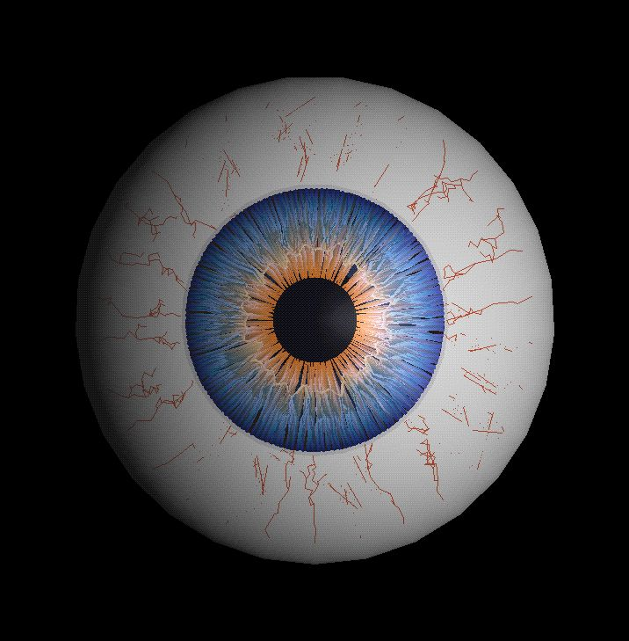
PRIMARY OPEN ANGLE GLAUCOMA(POAG)
BY:
Katidjah Rahim
Norsuriati Abd Khamis
Siti Zawani Mistoh @ Mastan

Slide 2
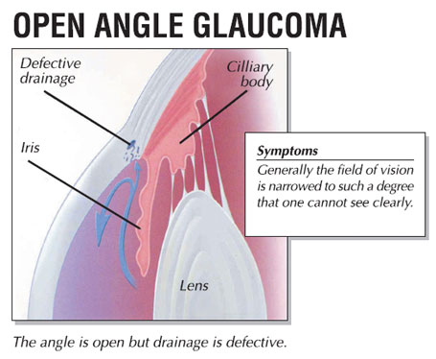
DEFINITION
Primary open-angle glaucoma is described as bilateral, non-congestive increase of IOP in absence of angle closure leading to optic nerve damage from multiple possible causes that is chronic and progresses over time, with a loss of optic nerve fibers.

Slide 3
INCIDENCE
Occur equally between male and female
Occur above age of 40 years old
More in black people (African – American)
Bilateral but one eye preceded before the other

Slide 4
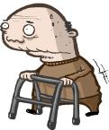
RISK FACTORS
AGE: Increasing risk after age 40 and continues to increase with each additional decade. Aging also can cause drainage channels in the trabecular meshwork to shrink or narrow, which slows the outflow of fluid from the eye.

Slide 5
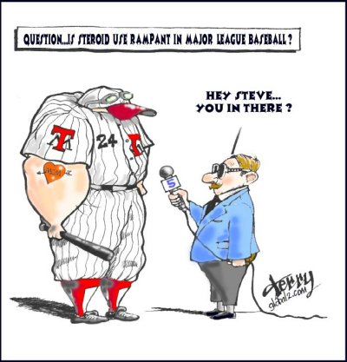
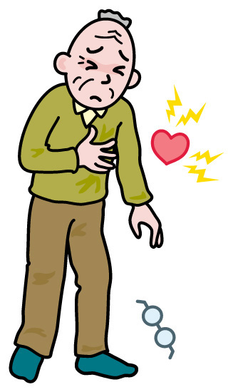
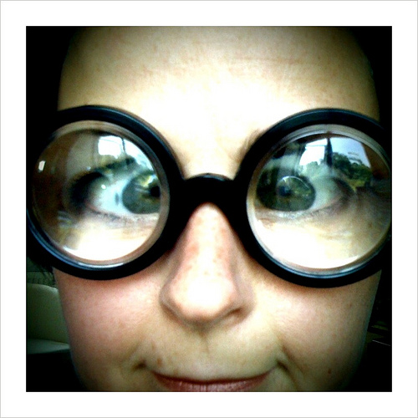
CERTAIN MEDICAL PROBLEMS:
Diabetes
High myopia
The use of oral or inhaled steroids
Migraine headaches,
high blood pressure, narrowed blood vessels (vasospasm) and cardiovascular disease.

Slide 6
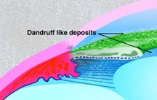
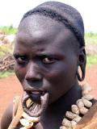
EYE ABNORMALITIES
Pseudoexfoliation syndrome causes proteins in the eye's natural lens, iris and other structures to slough off and clog the eye's drainage system.
RACE: three to four times more common in African-Americans than in whites.
FAMILY HISTORY:three to four times higher if one or more of your parents and siblings have the disease.

Slide 7
CLINICAL PICTURE
SYMPTOMS
- no acute symptom, and it may pass unnoticed until complete loss of vision. The symptoms may be:
a) headache or feeling of fullness
b) delayed dark adaptation
c) early presbyopia due to pressure on the ciliary nerves and weakness of ciliary muscle
d) blurring of vision and field loss are late symptoms

Slide 8
Signs
1- high tension
3- optic disc change
4- gonioscopically open angle
2- visual field changes
SIGNS

Slide 9
1-TENSION: (normal IOP is 10:20 mmHg by applanation tonometer)
Applanation tonometry should be used to avoid the factor of sclera rigidity
High IOP in presence of open angle is diagnostic but normal tension does not exclude POAG because early stages of the disease show wide fluctuation of the IOP , in this case we must resort to one of the following methods:

Slide 10
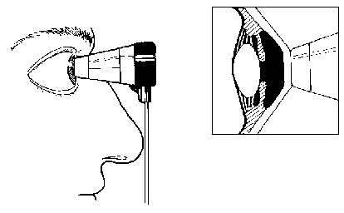
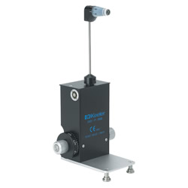

Slide 11
(A)IOP IN BOTH EYES:
-Normally does not exceed 4 mmHg, 8 mmHg or more are diagnostic.
(B)DIURNAL VARIATION
normally IOP is highest in the morning and goes to the minimum in the late evening but the variation is never more than 4 mmHg
the patient is hospitalized and IOP is measured every 4 hours for 24 hours . if diurnal variation exceed 8 mmHg, POAG is diagnosed.

Slide 12
(C)PROVOCATIVE TEST:
the aim of these test is to increase aqueos formation with faulty in the drainage system→rise of IOP
1- water drinking test: to measure the rise in IOP after drinking one liter of water. The IOP is measured every 15 minutes for 1-2 hours. A rise of 8mmHg or more is diagnostic.
2- Priscol test: 10mg of priscol is injected sub conjunctively. A rise of 11-13 mmHg is
Suspicious and 14 mmHg is pathological.
(D)TONOGRAPHY

Slide 13
2-OPTIC NERVE HEAD CHANGES (GLAUCOMATOUS CUPPING)
The normal disc is pink in colour and 1.5mm in diameter. It is divided into a central pale depression called optic cup (normally 0.3 of the disc in diameter) and a neuro-retinal rim sorrunding it.
The rim is composed of:
Papillo-macular bundle: from the macula (temporally)
Superior arcuate bundle: from superior temporal retina (up)
Inferior arcuate bundle: from inferior temporal retina (down)
Nasal bundle: from nasal retina (nasally)
*the arcuate bundles are susceptible to early damage in glaucoma producing vertical enlargement or notching of the cup and early central field changes.

Slide 15
Causes of glaucomatous cupping
mechanical factor: the rise of IOP lead to bowing of lamina cribrosa backward (weak area)
ischemic optic neuropathy: sclerosis of small optic nerve vessels→degeneration of optic N.F→ small empty spaces which coalesce→cavernous degeneration→CT contraction→backward retraction of the lamina→glaucomatous cupping.

Slide 16
Methods to record optic disc shape
Fundus photography
Nerve fiber layer analyzer
Conofocal laser opthalmoscope (CLO)
Optical coherence tomography (OCT)

Slide 17
Characteristic of glaucomatous optic disc cupping:
1-vertically oval
2- pale disc
3- wide cup
4- deep cup
5- Asymmetric cupping
6- Undermined edges (interrupted blood vessel at the cup margin)
7- Nasal shift of blood vessel
8- Splinter hemorrhage (flame shaped at the cup edge)
9- Progression of cupping (most important sign)

Slide 18
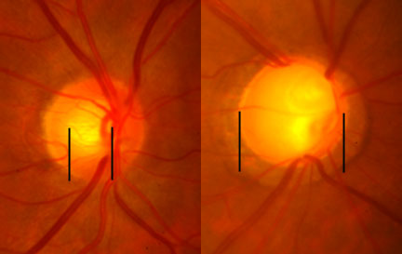

Slide 20
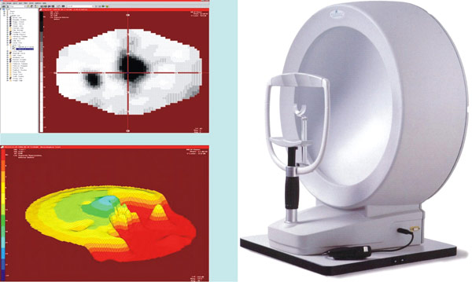
3-VISUAL FIELD CHANGES:
Central field changes:
-The central field (30 degrees) is examined by Bjerrum screen (campimetry) or the recent automated perimetry.

Slide 21
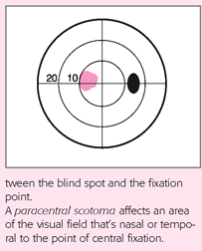
-Central field changes include:
(a)Isolated paracentral scotoma:
they are found early in glaucoma within Bjerrum area (central 20 degrees)

Slide 22
(b) Baring of the blind spot:
- exclusion of the blind spot from central field
(c) Seidl’s scotoma:
- extension of the blind spot above or below in a sickle shape manner.

Slide 23
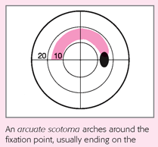
(d) Arcuate or Bjerrum scotoma:
- an arcuate scotoma continuous with the blind spot
- concentric with point of fixation and ends in the horizontal meridian
- it follows the arcuate fibers (typical nerve fiber bundle defect)

Slide 24
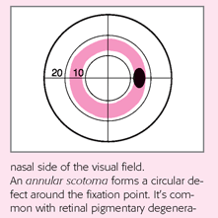
(e) Ring or annular scotoma
- fusion of upper and lower arcuate scotoma.

Slide 25
Peripheral field changes
Generalized contraction: more on the nasal side
Ronnie nasal step: the nasal contaction extend to the horizontal raphe
Terminal field: tubular field (central 5-10 degrees) with temporal island

Slide 26
GONIOSCOPICALLY OPEN ANGLE
Gonioscopy to visualise the iridocorneal angle utilises a contact lens to avoid the problem of total internal reflection which normally makes all angle structures invisible. ( The large difference in refractive index between the cornea and air has to be minimised. )

Slide 27
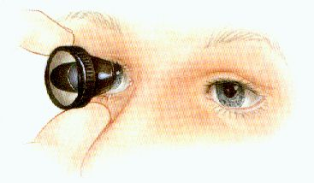
The Goldmann gonioscope has a highly curved anterior surface which needs to be filled with about 3 drops of normal saline or hypromellose before application to the anaesthetised cornea.

Slide 28
Under the Shaffer angle grading system each quadrant is given a grade from:-
0 :is closed (either contact or adhesion)
I :10-15 degrees
II :15 to 25 degrees
III :25 to 35 degrees
IV :40 or more derees

Slide 29
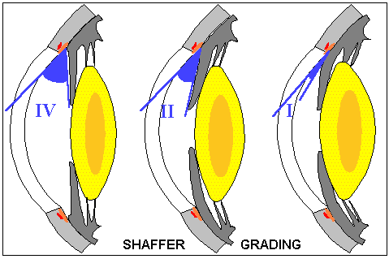

Slide 30
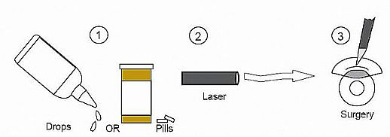
TREATMENT
The options for treatment of glaucoma include one or more of the following:
1. Medication
2. Laser trabeculoplasty
3. Filtration and other surgery

Slide 31
Medication & laser trabeculoplasty
Topical treatment | Systemic treatment
Miotics: Pilocarpine 1-4 % BB: - Timolol - Levobunolol - Betaxolol Adrenergic agonist: -epinephrine - Dipivifrin 0.1% Alpha agonist: Brimonidine 0.2% Topical CAI: - Dorzolamide PG analogues: - Latanoprost | CAIS: Diamox tab. Argon Laser Trabeculoplasty (ALT)

Slide 32
Surgical treatment
Indication :
Medical and laser treatment fail
Visual field deteriorates
Poor patient compliance
Inadequate ophthalmic care

Slide 33
Aim Of Surgery
Is to create a new pathway for aqueous to flow from A.C through a scleral opening into the subconjunctival or sub- Tenon’s space.

Slide 34
Operation For POAG
A)External Fistulizing Procedure
Subscleral trabeculectomy
Trabeculectomy plus mitomycin C (intra-operative) or 5FU (post-operative)
Laser sclerotomy
Non-penetrating fistulizing procedure e.g Visco-canaloplasty

Slide 36
B) Seton (Tube-Shunt) Surgery
C) Cilliary Body Destructive Surgeries
Cyclocyotherapy
Cyclodiathermy
Cyclophotocoagulation
Trans scleral (YAG OR diode laser)
Trans pupillary by Argon laser

Slide 38
D) Cyclodialysis (Internal Fistulizing Procedure)
*Indication :
Aphakic glaucoma
Posterior lens dislocation
Congenital aniridia

Slide 39
THANK YOU

