Slide 1
Let it begins with…
بسم الله الرحمن الرحيم

Slide 2
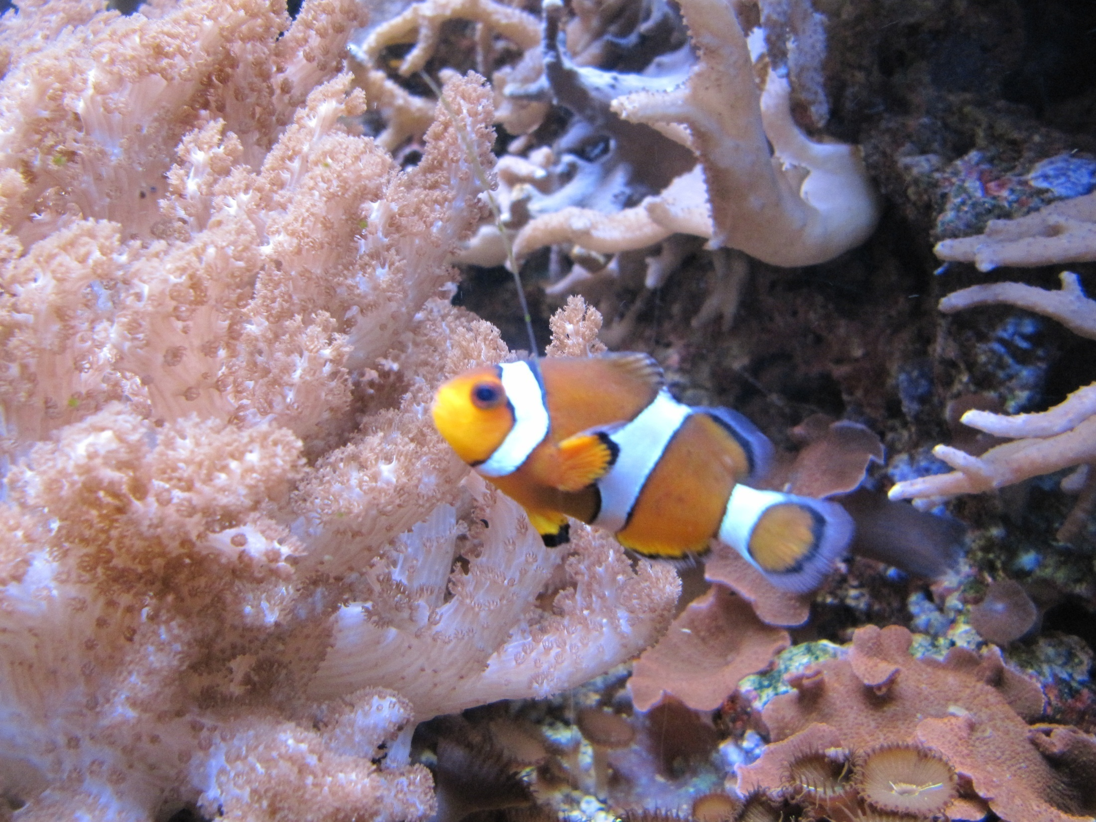
Blepharoptosis
by
Mohd Faiz Bin Mohd Azmi
Muhd. Irfan Aqli Bin Abdullah
Muhd. Syazwan Bin Mohd Nor

Slide 3
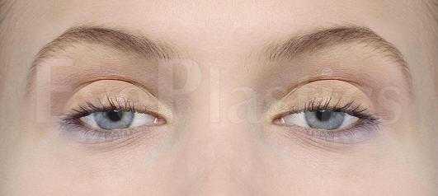
Definition
Ptosis is an abnormally low position (drooping) of the upper eyelid.

Slide 4
Introduction
Ptosis is also known as Blepharoptosis. It refers to an eyelid which is droopy.
This may cause a loss of vision, especially while reading, headaches, and eyebrow strain
It is a condition that may affect one or both eyes

Slide 5
Structures that holding our upper lids
Neurogenic
Myogenic
aponeurotic
Hysterical
mechanical

Slide 6
Classification
Can be classified according to its etiology into
Congenital (B) Acquired

Slide 7
(A) Congenital Ptosis
Definition: Ptosis that is present since birth

Slide 8
What is the problem in this congenital ptosis? (cause)
a) Neurogenic b) Myogenic

Slide 9
a) Neurogenic congenital ptosis
occur when the innervation to the levator is interrupted through neurologic or neuromuscular junction dysfunction.
includes oculomotor nerve palsy, Horner's Syndrome, Marcus Gunn jaw winking syndrome, III rd cranial nerve misdirection.
Any other condition than include nerve manifestation may cause ptosis

Slide 10
Marcus Gunn Jaw-Winking Phenomenon

Slide 11
b) Myogenic congenital ptosis
Rather than normal muscle fibers, fibrous and adipose tissues are present in the muscle belly, diminishing the ability of the levator to contract and relax. Therefore, the condition is commonly called congenital myogenic ptosis.
which includes myotonic dystrophy,
ocular myopathy, simple congenital ptosis, blepharophimosis syndrome.

Slide 12
Chin-up posture due to congenital ptosis of the left eye.

Slide 13
Congenital ptosis of the left eye partially obstructing the left pupillary axis.

Slide 14
Congenital ptosis of the right eye.

Slide 15
Something we should know..
In approximately 70 percent of cases, the condition affects only one eye.
If the drooping eyelid obscures part of the baby’s visual fields, surgery must be performed to correct the problem early in life to prevent permanent loss of vision.

Slide 16
B) Acquired ptosis
Classified into
Aponeurotic Mechanical Traumatic
Some special disorder

Slide 17
Aponeurotic ptosis
senile or age-related ptosis— This is the most common cause of ptosis
How it happens?
long-term effects of gravity and aging cause a stretching of a wide, tendon-like tissue; that helps the levator muscle lift the eyelid (aponeurosis)

Slide 18
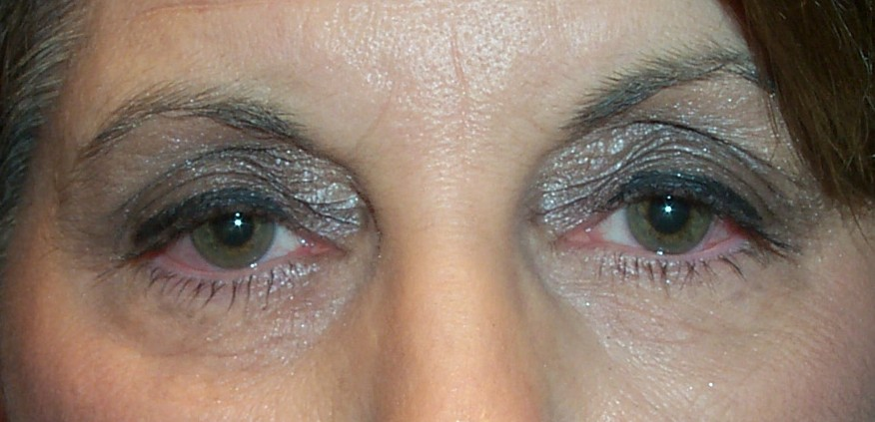

Slide 19
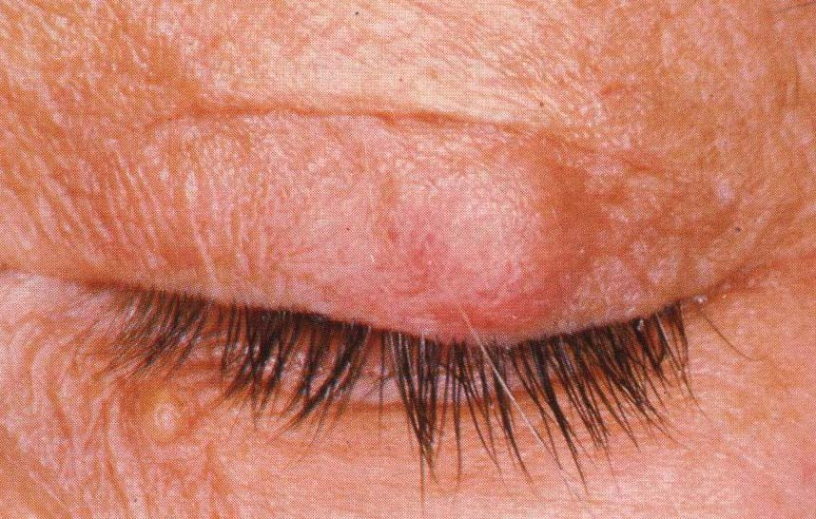
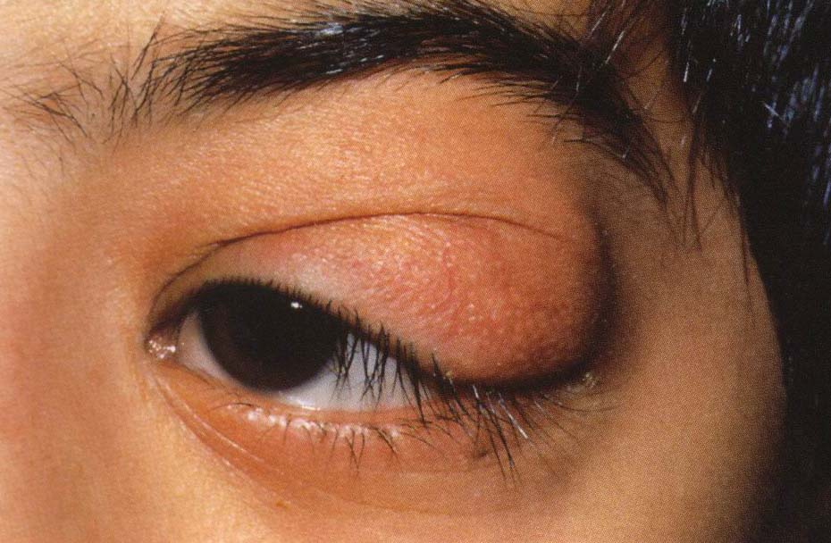
Mechanical ptosis
occurs due to edema, swelling or tumor of the upper lid*
*pics from Prof Dr Ahmed Tawfik

Slide 20
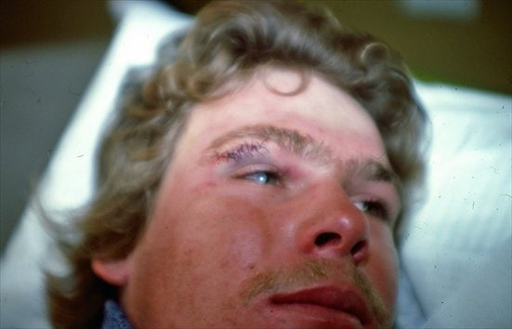
Traumatic ptosis
Injury of the roof of the orbit (levator muscle or its nerve supply)

Slide 21
Blepharophimosis
Inherited disorder
is a condition where the patient has bilateral ptosis with reduced lid size, vertically and horizontally. The nasal bridge is flat and there is hypoplastic orbital rim.
Both the vertical and horizontal palpebral fissures (eyelid opening) are shortened. Vignes (1889) probably first described this entity, a dysplasia of the eyelids

Slide 22
Myasthenia gravis
Systemic disorder
a rare disorder that affects the ways muscles respond to nerves.
Myasthenia gravis can produce progressive muscle weakness, not only in the eyelids but also in the facial muscles, arms, legs and other parts of the body

Slide 23
Pseudoptosis
It is appearance of ptosis but with false causes of its drooping of eyelid

Slide 24
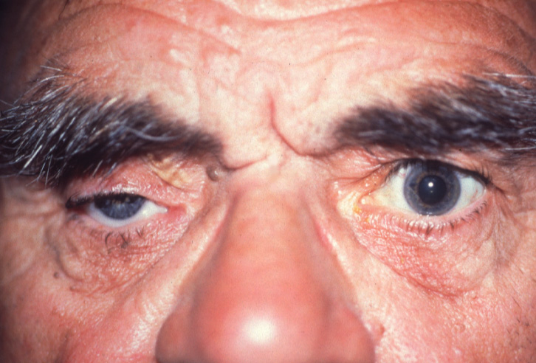
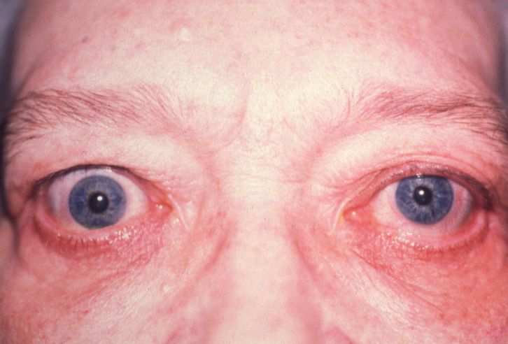
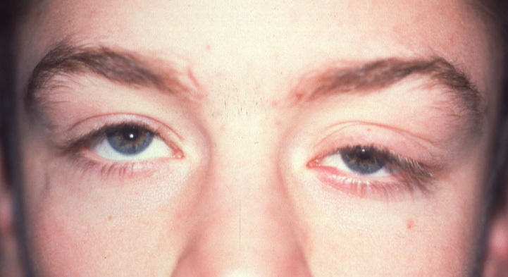
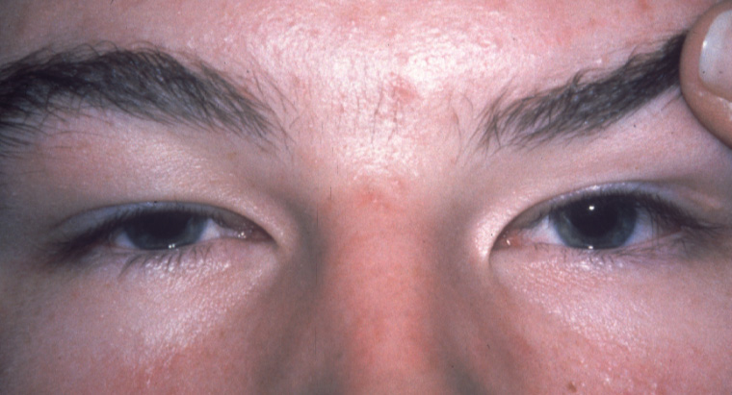
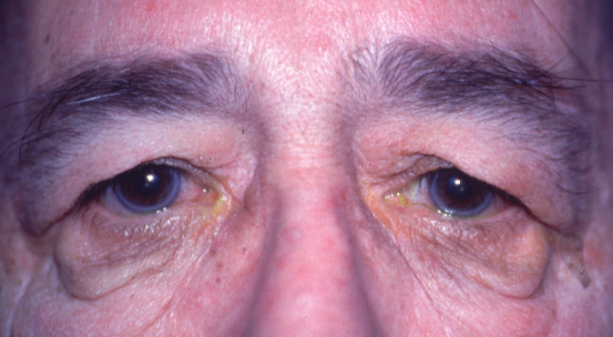
Causes of Pseudoptosis
Lack of lid support
Contralateral lid retraction
Ipsilateral hypotropia
Brow ptosis - excessive
eyebrow skin
Dermatochalasis - excessive
eyelid skin

Slide 25
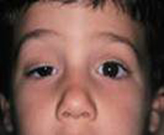
MANAGEMENT OF A CASE OF PTOSIS

Slide 26
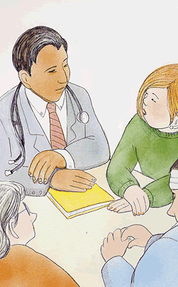
HISTORY
Personal history
Age of onset
History of fever
Family history

Slide 27
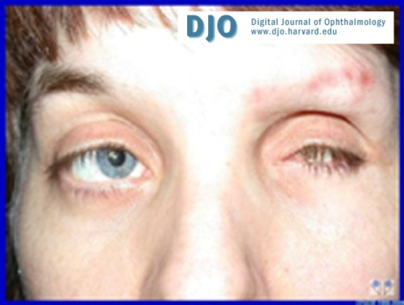
EXCLUDE PSEUDOPTOSIS
Contralateral lid retraction
Narrow palpebral fissure
Enophthalmos
Atrophia bulbi
Microphthalmia

Slide 28
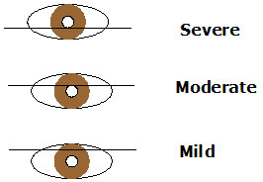
MEASUREMENT
Marginal reflex distance
Vertical fissure height
Levator function
Associated signs:
Superior rectus weakness
Jaw-winking
Phenylephrine test
Bell`s phenomenon
Corneal sensitivity

