Slide 1
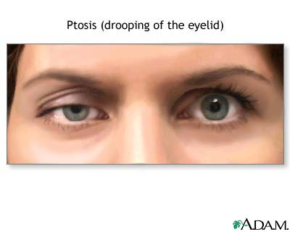
Surgical Treatment of Ptosis

Slide 2
Overview
Indication of Surgery
Contraindication of Surgery
Timing of Surgery
Relevent Anatomy
Type & Choice of Operation
Preoperative Details
Intraoperative Details
(Choosing Approaches & Techniques)
Postoperative Care & Follow-up
Complications

Slide 3
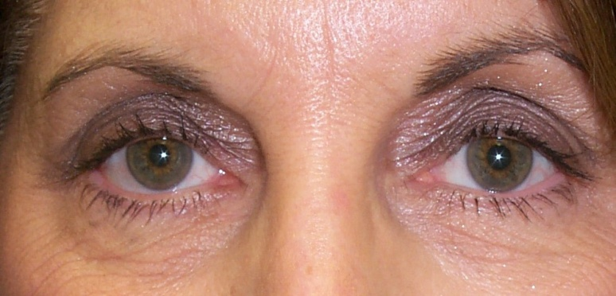
Our Goal

Slide 4
Indication of Surgery
Contraindication of Surgery
Congenital ptosis
Acquired ptosis after treatment of the causes failed or impossible (except in mythenia gravis, hysterical ptosis or pseudo-ptosis)
Complete III nerve paralysis (except after treatment of paralytic squint to prevent diplopia)
Corneal anesthesia or absence of Bell’s phenomenon

Slide 5
Timing of Surgery
Mild & moderate (partial ptosis, pupil uncovered with good vision & no torticollis)
After age of 5 years (preschool age):
Associated epicanthus is done first at the age of 10 years for growth of nasal bridge
Severe (complete) ptosis
At younger ages ( even at the age of 6 months): to avoid Amblyopia
Organic changes in the muscle and ligaments (ocular torticollis)

Slide 6
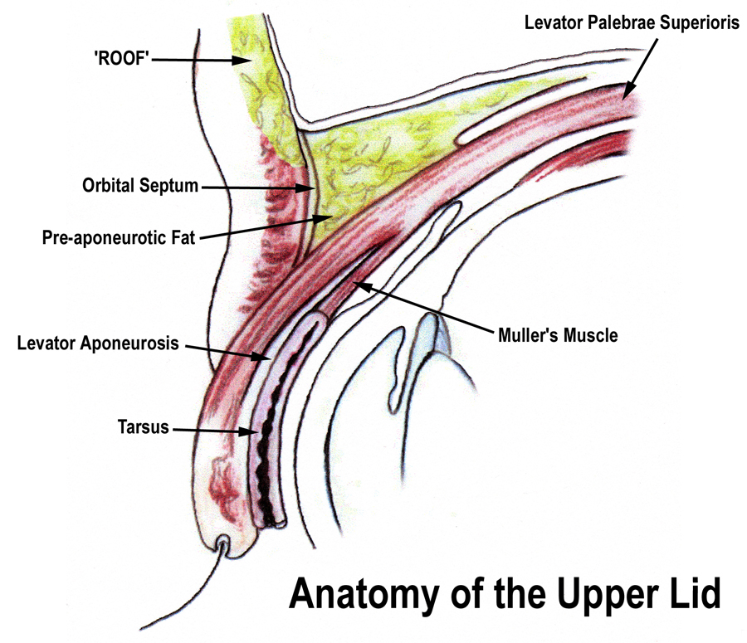
Choices structure for Resection
Important Landmark
In the surgery

Slide 7
Type of Operation
Levator Resection: either Blascovic’s or Everbusch’s Operation
Muller Muscle Resection
Frontal Sling Operation

Slide 8
Choice of Operation
Mild ptosis (2mm) with good levator function (>8mm) :
Fasanella-Servant Operation
Moderate or severe ptosis (>2mm) with good or fair levator function
Blascovic Operation:
Everbusch’s Operation
Complete Paralyzed Levator Muscle : by Frontal Sling

Slide 9
Preoperative Details (Anesthesia)
General anesthesia
necessary for all children.
congenitally ptotic lid may appear less ptotic; therefore, marking the lid to avoid surgery in the wrong lid
Local anesthesia: is adequate for adults and is much preferred for some types of ptosis.
obtained with a simple subcutaneous injection of 1.5-2 mL of anesthetic across the breadth of the lid.
Intraorbital injection is not necessary, and if patient cooperation is desirable for setting the lid height, avoid injection behind the orbital septum. This type of injection avoids levator akinesia, thus allowing the levator muscle to function normally intraoperatively.
Plain lidocaine (2%), lidocaine with epinephrine, or a lidocaine-bupivacaine mixture are all satisfactory.

Slide 10
Intraoperative Details (Choosing Approaches & Techniques)
Frontalis sling (modified Crawford technique)
Levator resection
Anterior approach for levator aponeurosis repair
Orbicularis plication for ptosis

Slide 11
Frontalis sling (modified Crawford technique)
Choosing the material as the sling:
Generally surgeons agree using autologous fascia lata or preserved fascia lata (as a second choice) placed as a double rhomboid, single rhomboid, or triangular sling from the frontalis to the lid produces the best result.
Other materials, such as catgut, collagen, Prolene, silicone, stainless steel, silk, skin, Supramid, sclera, tantalum, tarsus, and recently Mersilene mesh, umbilical vein, tendon, and other new synthetics, have been tried.
Principle: Transfering the lift of the upper lids to frontalis muscle

Slide 12
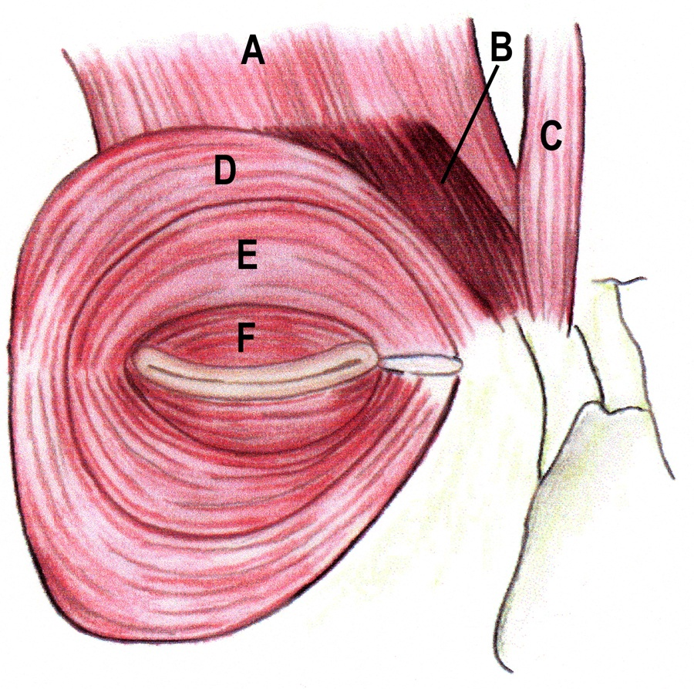
Orbicularis oculi muscle anatomy
Frontalis,
Corrugator superciliaris,
Procerus,
Orbital orbicularis,
Preseptal orbicularis,
Pretarsal orbicularis.

Slide 13
Result (cont’):
using a sling for unilateral ptosis produces a cosmetic blemish on downward gaze because the motion of the lid is restricted when following the downward movement of the globe; however, The patient can learn to move one side of the brow to set the lid level close to that of the unaffected side and can ease the brow on downgaze to minimize asymmetry.
Use of a bilateral sling is now accepted in patients with unilateral ptosis or with unilateral jaw-winking phenomenon to give symmetry to the 2 lids. This is felt by some to be cosmetically pleasing and to give coordination to the movements of the lids as they follow the globe in the up and down positions

Slide 14
Levator resection
Principle:
Strengthening the levetor muscle by its resection (shortening) and recession of its insertion
Type
Blascovics Operation: Conjuctival approach; with or without partial tarsectomy
Everbusch’s Operation: Skin approach
Orbicularis plication for ptosis
This procedure involves exposure of the orbicularis oculi muscle via a skin flap that starts near the upper orbital margin and progresses downward. The orbicularis oculi fibers near the lid margin are then joined to the proximal orbicularis fibers and the skin flap is sutured back to normal position.
Anterior approach for levator aponeurosis repair

Slide 15
Muller’s muscle Resection
Surgical technique illustrated: (a) local anaesthetic infiltration, (b) Müller's muscle stripped from the aponeurosis, (c) subtotal resection of Müller's muscle. (d) 5/0 silk passed through forniceal conjunctiva, Müller's muscle stump, the upper border of tarsal plate (e), and through to the skin crease (f). Two further double-ended 5/0 silk sutures are passed (g), and tied over cotton bolsters (h,i).

Slide 16
Postoperative Care
With levator resection or a fascia sling procedure, in which some lagophthalmos is expected, the lower lid is pulled up with a modified Frost suture to cover the cornea.
Place antibiotic ointment in the eye and apply a light patch, which should be left in place for 24 hours. Use an antibiotic-steroid ointment on the suture line during the postoperative period and in the eye to guard against possible drying. Generally, only 1-2 weeks of ointment use is necessary for complete adjustment to the new situation. The patient is seen on the first postoperative day mainly to look for exposure problems and infection. If evidence of surface drying or a persistent epithelial defect is observed, the Frost suture may be left in place until healing occurs.

Slide 17
Follow-up
Remove the sutures 5-7 days postoperatively and recheck the patient.
If lagophthalmos seems severe and the patient is unable to close the eye, the lid may be taped closed at nighttime, or a bubble-shield moisture chamber may be placed for protection in addition to generous ointment application.
Once the repair is stable, a final visit in 1-2 months allows evaluation of the result.

Slide 18
Complications
Undercorrection
Most often, undercorrection is caused by inadequate resection of the levator tendon owing to inadequate preoperative evaluation.
Misplaced sutures or slippage of sutures in the postoperative period may also cause this complication. These situations can usually be avoided by careful preoperative evaluation and careful surgery.
Unfortunately, occasional undercorrections occur even when proper preoperative evaluation and excellent surgical technique are used.
Overcorrection
Overcorrection in a patient with acquired ptosis, particularly levator dehiscence, is rather easy to produce if a levator resection is performed rather than simply a repair of the dehiscence. This problem was more frequent before the pathophysiology of this type of ptosis was recognized and when the defect was treated with either anterior or conjunctival approach levator resection.

Slide 19
Complications (cont’)
Poor or improperly positioned lid crease
may occur if the skin incision is placed incorrectly or if the skin and orbicularis muscle are not fixated to the levator aponeurosis during the skin closure.
Peaking of the lid
Peaking of the lid rarely occurs with levator resection if the tarsus is left intact, since its width serves to stabilize the lid contour. However, if sutures are placed unevenly or if suturing is directly to the tarsus in one area and to pretarsal tissues in another, contour problems are more likely to occur.
Exposure keratitis
Corneal abrasion
Result from sutures inadvertently placed through the tarsus or conjunctival surface.
Lagophthalmos
Infection and inflammatory reactions
Double vision
Usually, postoperative diplopia is due to direct damage to the superior rectus muscle and sometimes the superior oblique muscle
Rarely due to direct nerve damage.

Slide 20
Reference 1. Clinical Ophthalmology for Medical Students, by Staff Members of Ophthalmology Department Zagazig, 3rd edition 2. http://www.ptosis.us/ 3. http://emedicine.medscape.com/article/839075-overview 4. Author: Mounir Bashour, MD, CM, FRCS(C), PhD, FACS, Assistant Professor of Ophthalmology, McGill University; Clinical Assistant Professor of Ophthalmology, Sherbrooke University; Medical Director, Cornea Laser and Lasik MD 5. http://emedicine.medscape.com/article/1212815-treatment 6. http://www.nature.com/eye/journal/v17/n9/full/6700623a.html 7. http://emedicine.medscape.com/article/834932-media

