Slide 1
Prepared by: Liyana Ashaari Nur Adila Kamaruddin Nur Liyana Omar
RETINAL DETACHMENT

Slide 2
RETINA
innermost of three layers that make up the eyeball’s wall. The layer outside the retina is the choroid
Anatomically, retina divided into:
1- CENTRAL RETINA : (macula lutea =5-7.5mm) The center of macula is an avascular depression called “fovea centralis”
Function: (mainly cones) responsible for visual acuity, color vision and form sense
2- PERIPHERAL RETINA : end at ora serrata
Function: (mainly rods) responsible for night vision and peripheral field

Slide 3
Layer of retina
Inner limiting membrane - Müller cell footplates
Nerve fiber layer
Ganglion cell layer - Layer that contains nuclei of ganglion cells and gives rise to optic nerve fibers.
Inner plexiform layer
Inner nuclear layer contains bipolar cells
Outer plexiform layer - In the macular region, this is known as the Fiber layer of Henle.
Outer nuclear layer
External limiting membrane - Layer that separates the inner segment portions of the photoreceptors from their cell nucleaus.
Photoreceptor layer - Rods / Cones
Retinal pigment epithelium

Slide 4
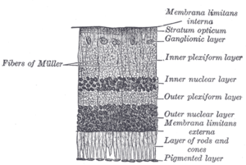
Histology of the retina

Slide 5
RETINAL DETACHMENT

Slide 6
RETINAL DETACHMENT
DEFINITION: it`s a condition in which the retina is separate into 2 layer
1- retina pigment epithelium
2- sensory retina
by subretinal fluid

Slide 7
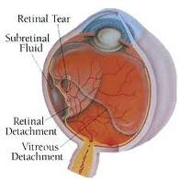
What detaches the retina
Retina break
Traction on break
Moving fluid (shaking )

Slide 8
Types of retinal detachment
EXUDATIVE RD
TRACTIONAL RD
RHEGMATOGENOUS RD

Slide 9
Rhegmatogenous retinal detachment

Slide 10
RHEGMATOGENOUS RD
DEFINITION :
Formation of retinal tear , which allow the liquefied vitreous to enter between the retinal layers causing retinal detachment formation

Slide 11
RISK FACTORS
Blunt trauma
Aphakia
Chorio- retinal degeneration ( high myopia)
Family history
Chorio-retinitis

Slide 12
incidence
patient : > 40 years
Sex : more male
Refraction : > myopia
Bilateral in >10 % of cases

Slide 13
Clinical pictures
Symptoms
Flashes of light ( photopsia )
Due to mechanical traction of rods & cones by vitreous traction
Floaters ( musca volitans )
Due to vitreous degenaration
Field defect ( black curtain )
Due to death of photoreceptor
Failure of vision ( HM or PL vision )
Due to foveal detachment

Slide 14
Signs
Pupil : Relative Afferent Pupillary Defect when the detachment is extensive
IOP :
Ant. chamber : mild inflammatory cells
Post. Segment :
(i) Retinal breaks: as full thickness defect in sensory retina. Look red in color due to color contrast between the sensory retina and underlying choroid
(ii) Detached retina : greyish in color, has corrugated appearance and undulates with eye movement. The retina surface is convex and subretinal fluid extends to ora serrata rapidly

Slide 15
management
To find all retinal break by
(i) Preoperative exam
(ii) Intraoperative exam
To close all retinal break
(i) Scleral buckle
(ii) intra-vitreal gas bubble
To create firm chorio retinal adhesion
(i) cryotherapy
(ii) Diathermy
(iii) Laser photocoagulation.

Slide 16
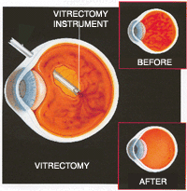
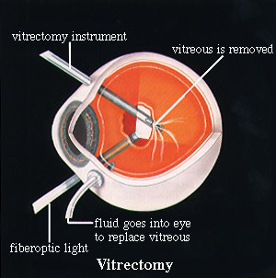
Vitrectomy
Is indicated in case of rhegmatogenous retinal detachment associated with giant tear, post retinal tear or proliferative vitreoretinopathy

Slide 17
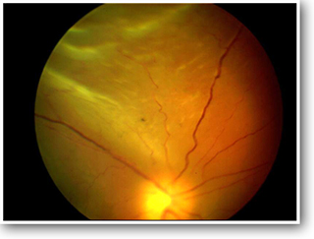
Rhematogenous retinal detachment

Slide 18
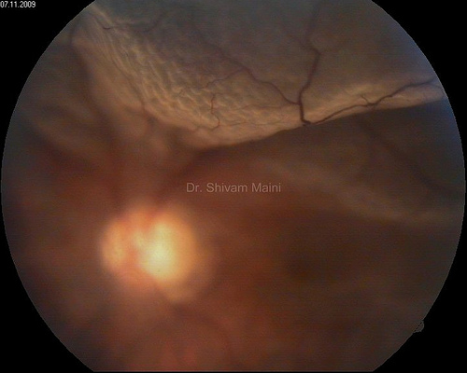
Rhematogenous retinal detachment

Slide 19
EXUDATIVE RETINAL DETACHMENT

Slide 20
EXUDATIVE retinal detachment
DEFINITION: Extravasation of fluid from the retina or choroid into the subretinal space
TREATMENT:
Inflamatory (choroiditis & post scleritis) → give cortisone
Malignant → enucleation

Slide 21
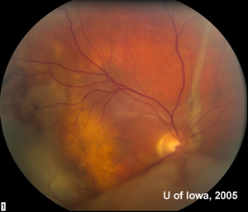
Exudative retinal detachment

Slide 22
TRACTIONAL RETINAL DETACHMENT

Slide 23
Tractional retinal detachment
DEFINITION: The retina is pulled from it`s position by contracting fibrous or fibro-vascular membranes
TREATMENT: vitrectomy

Slide 24
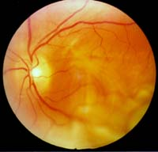
Tractional retinal detachment

Slide 25
Differential diagnosis
 | RHEGMATOGENOUS RD | EXUDATIVE RD | TRACTIONAL RD
RETINAL BREAK | -PRESENT | -NO | -NO
SURFACE & HEIGHT | -CONVEX | -CONVEX | -CONCAVE
RETINAL MOBILITY | -UNDULATING BULLAE OR FOLDS | -SHIFTING ELEVATED BULLAE | -TAUT RETINA
EXTENT OF RD | -EXTENDS TO ORA SERRATA EARLY | -MAY EXTEND TO ORA | -DOES NOT EXTEND TO ORA
SRF | -CLEAR, NO SHIFT | -TURBID,SHIFT | -CLEAR, NO SHIFT
IOP | -LOW | -VARIABLE | -USUALLY NORMAL
CAUSES | -RETINAL BREAK | -UVEITIS,SUBRETINAL NEOVASCULAR, TUMOR | -PDR,RETINOPATHY OF PREMATURITY

Slide 26
THANK YOU

