Slide 1
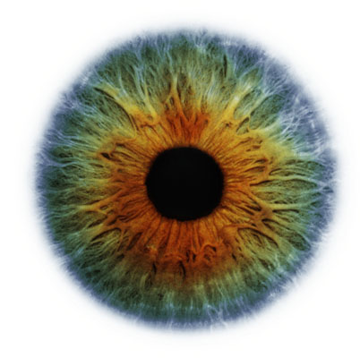
SENILE CATARACT
BY : Azlizan Supian
Safiyyah Aminudin
Nor Aizah Muhammad

Slide 2
DEFINITION
* Gradual opacification of the lens affecting old people above 50 years old and not suffering from local or systemic disease.
* Usually bilateral and occurs equally in men and women
GRADUAL DIMINUTION OF VISION
PROGRESSIVE COURSE
PAINLESS

Slide 3
CLINICAL TYPES
SENILE CORTICAL CATARACT
SENILE NUCLEAR CATARACT
STAGES :
* Incipient
*Immature
*Intumescent
*Mature
*Hypermature

Slide 4
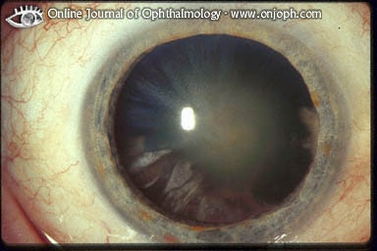
Incipient stage : * Wedge-shaped opacity with apex directed toward the centre of the lens * Red reflex appears as black sectors against red background

Slide 5
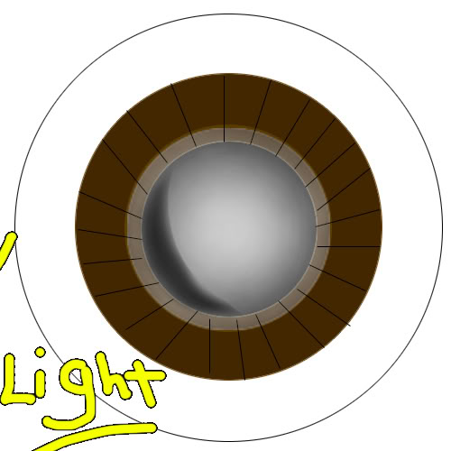
Immature stage : * Opacity of the entire cortex except for the superficial zone under the capsule. * Grayish lens with iris shadow appearance. * Red reflex is markedly decrease

Slide 6
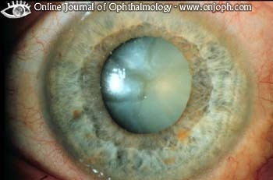
Intumescent cataract : * May occur or may not occur * It may induce pupillary block ( phacomorphic ) glucoma
Accumulation of the degenerated particles of the lens protein
Increase osmotic pressure inside the lens
Lens continue to absorb an increasing amount of aqueous & become swollen with stretched glistening capsule

Slide 7
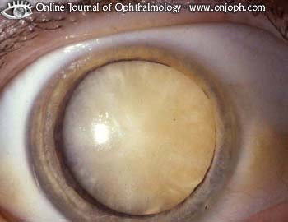
Mature stage :
* Opacity reaches the subcapsular fibers & lens appears
white
* Visual acuity is hand movement
* Grayish white red reflex
* No iris shadow

Slide 8
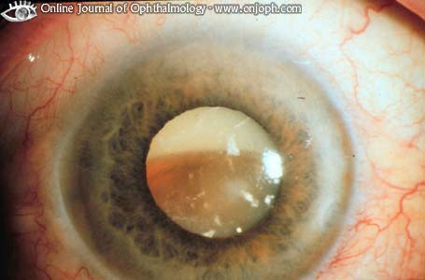
Hypermature stage : *Degenerated lens matter escape from lens through the intact capsule with shrinkage of the lens *The anterior chamber is deep and the iris is tremulous *Iris shadow can be seen * It occurs if the degenerated lens matter are retained and liquefied within the capsular bag allowing the nucleus to sink inferiorly. (sunset appearance)
SHRUNKEN TYPE
MORGAGNIAN TYPE

Slide 9
* phacolytic glaucoma * Subluxation or dislocation of the lens * phacoanaphylactic uveitis
COMPLICATIONS OF
HYPERMATURE CATARACT

Slide 10
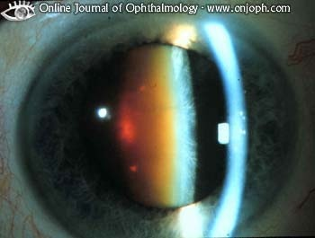
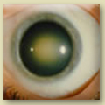
SENILE NUCLEAR CATARACT
* As a result of nuclear sclerosis
* It takes a very long time to become mature
* No stage of intumescent or shrinkage
* Due to melanini deposition,it appears yellow,brown,deep
brown and may be black in excessive melanin deposition
( Cataracta nigra )
* Red reflex is seen peripherally around central black disc

Slide 11
CLINICAL PICTURE SYMPTOMS :
* Gradual progressive painless diminution of vision (never below H.M)
* Night blindness in cortical cataract and day blindness in nuclear cataract.
* Fixed black spots in the field of vision.
* Uniocular diplopia or polyopia (incipient cataract).
* Index myopia in nuclear cataract. This may improve presbyopia and the condition is referred to as second sight
* Index hypermetropia in cortical cataract.
* Halos around light in cortical cataract.
* Rapid diminution of vision in intumescent cataract.
* Red eye, headache, and ocular pain in phacomorphic or phacolytic glaucoma.

Slide 12
SIGNS :
 | Immature | Mature | Intumescent | Hypermature
V.A | Better than H.M | H.M | H.M | H.M
R.R | Black sectors against red background | Absent (grayish reflex) | Absent | Absent
Iris shadow | present | absent | absent | May be present
AC depth | Normal | Normal | Shallow | Deep
Pupil | RRR | RRR | Normal except with secondary closed angle glaucoma | RRR
Ant. capsule | Normal | Normal | Glistening | Thick
IOP | Normal | High | May be high

Slide 13
DIFFERENTIAL DIAGNOSIS Immature cataract : 1) Senile sclerosis of the lens : The visual acuity is good and red reflex is intact. 2) From other causes of gradual painless diminution of vision Mature cataract : Grayish white cataract 1) Complicated cataract which appears chalky white

Slide 14
THE CHOICE OF OPERATION
Extracapsular Cataract Extraction (ECCE)
* The operation of choice for routine cataract extraction.
* ECCE involves the removal of the lens nucleus through an opening in
the anterior capsule with retention of the integrity of the posterior capsule.
* ECCE possesses a number of advantages over ICCE, most of which are
related to an intact posterior capsule, as follows:
1) Small incision with less postoperative astigmatism
2) Less incidence of :
-Vitreous loss
-Infection
-Glaucoma
-Cystoid macular edema
-Retinal detachment
3) Allows implantation of posterior chamber IOL

Slide 15
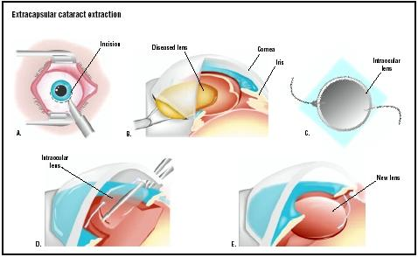
The main requirement for a successful ECCE and posterior capsule
IOL implantation is zonular integrity. As such, when zonular support
is insufficient or appears suspect to allow a safe removal of the cataract
via ECCE, ICCE or pars plana lensectomy should be considered.

Slide 16
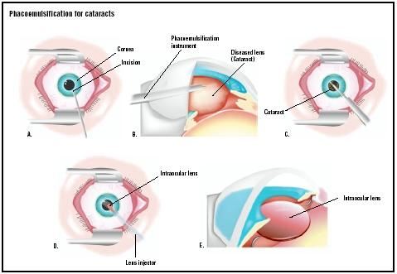
PHACOEMULSIFICATION
Phacoemulsification has the following advantages over ECCE :
1) Small incision ( sutureless )
2) Foldable ( Acrylic or Silicone IOL implantation )
3) Less astigmatism
4) Rapid visual recovery
Irrigation
Aspiration
Emulsification

Slide 17
The major intraoperative complications encountered
during cataract surgery:
* Expulsive choroidal hemorrhage * Corneal edema
* Shallow or flat anterior chamber * Retained lens material
* Suprachoroidal hemorrhage or effusion * Capsular rupture
* Vitreous disruption and incarceration into wound
Postoperative complication
* Corneal edema * Delayed formation of the AC
* Iris prolapse * Hyphema
* Iridocyclitis * 2ry glaucoma
* Drawn up pupil * Retinal detachment ( late )
* Endophthalmitis
* Opacification of the posterior capsule

