Slide 1
XEROSIS
Mohd Shafiq Bin Paridin
Mohd. Firdaus Bin Jamalullail
Nik Mohd Abduh Bin Nik Mhd Nor
4th Year Medical Student
Faculty Of Medicine, Zagazig University

Slide 2
INTRODUCTION

Slide 3
Definition:
dryness of the conjunctiva and or the cornea.
Xerosis also known as:
xeropthalmia
dry eye
XEROSIS

Slide 4
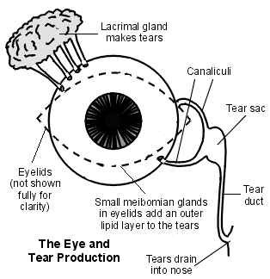
The tear film is made up from three layers :
the thin inner mucus layer.
the main middle watery layer.
the thin outer lipid (oily) layer.
XEROSIS

Slide 5
ETIOLOGY

Slide 6
Dry Eye Causes
Hyposecretive causes 1. Sjögren syndrome Primary - not associated connective tissue disease Secondary - associated connective tissue disease (e.g. rheumatoid arthritis) 2. Non Sjögren syndrome: Age-related Hormonal (including oral contraceptives) Drugs (e.g. anti-histamines) Vitamin A deficiency Infiltrative process (e.g. lymphoma) Neurological lesions (e.g. Riley-Day syndrome) Absence / abnormality of lacrimal gland / ductules Idiopathic | Evaporative causes Deficiency of oily component of tear film (e.g. meibomian gland dysfunction) Defective corneal resurfacing (e.g. lid malaposition) Blink disorders Contact lens wear
XEROSIS

Slide 7
CLINICAL PICTURE

Slide 8
Symptoms
Gritty irritation and foreign body sensation
Burning or pain, aggravated by air conditioning, prolonged reading or computer work, dry air etc
Stringy mucus discharge
Transient blurring of vision
XEROSIS

Slide 9
Signs
1.Lusterless Conjunctiva
Conjunctiva appears dry wrinkled and lost its luster
2.Bitot spots
Bitot spot formed from keratinized epithelium. They are triangular white patches on the outer conjunctiva covered by foamy materials.
XEROSIS

Slide 10
XEROSIS
BITOT’S SPOT

Slide 11
DIAGNOSIS

Slide 12
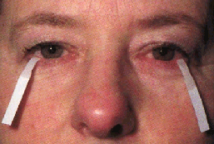
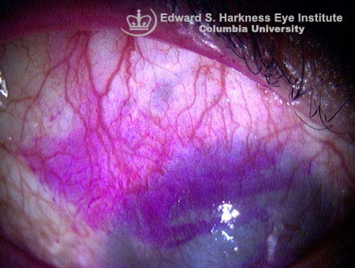
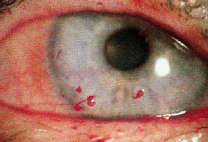
Method for diagnosis:
Schirmer test
Tear break-up test
Rose Bengal staining
XEROSIS

Slide 13
Differential diagnosis
Blepharitis - this often co-exists with a degree of dry eye.
Blocked nasolacrimal duct - this can cause tears to overflow and therefore inefficiently coat the cornea so causing a paradoxical dry eye.
Floppy eyelid syndrome - overweight male patients with floppy and easily everted upper eyelids associated with chronic papillary conjunctivitis of the upper palpebral conjunctiva.
XEROSIS

Slide 14
Complications
Dry eyes are more susceptible to infections. These may be superficial, e.g. conjunctivitis. However, if the dry eye is severe, corneal complications (infection, ulceration and rarely, perforation) may occur.
Other complications are:
Decreased visual acuity
Blindness
XEROSIS

Slide 15
TREATMENT

Slide 16
If cases due to vitamin A deficiency, we treat them by vitamin A supplement and diet.
If cases are caused by local causes:
Treat the causes
Preservative free artificial tears
Moisten the conjunctiva with 1% methyl cellulose drops
Therapeutic contact lens with high water content with artificial tears
Punctual occlusion by lacrimal plugs
Transplantation of the parotid duct into the conjunctiva sac may be tried in severe cases
Bitot spots may be scraped with a sharp spoon and painted with carbonic acid.
XEROSIS

Slide 18
Syokran
شكرا

